Slide 1
Team A 15
M.Som.Praneeth - CB.SC.U4AIE24029
Marada Jaya Krishna-CB.SC.U4AIE24030
Kolar Usman-CB.SC.U4AIE24024
M Phanendra-CB.SC.U4AIE24032

Slide 2
Integrated Image Restoration Using Machine Learning and Kernel Refinement Techniques
A Hybrid MATLAB + Deep Learning Approach for Image Deblurring

Slide 3
Introduction
Traditional Techniques:
Techniques such as Wiener filtering and Richardson-Lucy deconvolution have been standard solutions. These methods often utilize a known or estimated point spread function (PSF) to restore the image.
Limitations:
traditional methods struggle with complex blur patterns caused by camera shake, multiple motion blurs, and defocus that vary across the image scene.
Performance Issues:
Traditional methods are also prone to artifacts like ringing, noise amplification, and oversharpening, particularly in scenarios where the blur kernel is not accurately known or varies spatially across the image

Slide 4
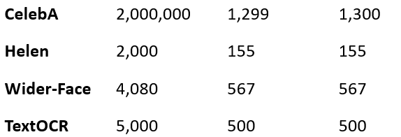
About dataset
https://www.kaggle.com/datasets/jishnuparayilshibu/a-curated-list-of-image-deblurring-datasets
Folder name Training images Validation Images Test image

Slide 5
Objective pipeline
1
2
3
4
Image Deblurring using Traditional Techniques
Sending the deblured image by Traditional method to ML model
MPRnet Deblurring the image
Giving a deblurred image as an output
.
•Develop a deep learning model (MPRNet) trained on paired blurred-sharp images.
•Enhance deblurring results by using kernel refinement techniques.
•Integrate MATLAB for traditional deblurring before ML inference.
•Analyze model performance using PSNR, SSIM, and loss curves.

Slide 6
MATLAB Preprocessing (Traditional Deblurring)
Richardson-Lucy (RL) deconvolution:
It an iterative algorithm used for restoring a sharp image from a blurred image, given a known Point Spread Function (PSF). It is widely used in image processing, astronomy, and microscopy for improving image clarity.
Mathematically, a blurred image 𝐵(𝑥,𝑦) is formed by:
B(x,y)=S(x,y)∗PSF(x,y)+N(x,y)
S(x,y) = Sharp (original) image; B(x,y) = Blurred observed image ; PSF(x,y) = Blur function (how the image got blurred) ; N(x,y) = Noise ∗ = Convolution operation

Slide 7
1: Start with an Initial Guess : We do not know the original sharp image S(x,y) hence we start by making an initial guess.
A practical and simple initial guess is the blurred image itself: S0(x,y)=B(x,y)
2: Simulate the Blurring Process
Using our initial guess S0(x,y); we simulate the blurring with a known Point Spread Function (PSF):
B_estimate(x,y)=S0(x,y)∗PSF(x,y)
3: Compare with the Real Blurred Image with estimated blurred image :
We calculate the element-wise ratio between them:
𝑅(𝑥,𝑦)=𝐵(𝑥,𝑦)/𝐵_estimate(𝑥,𝑦)
* If R(x,y)=1, our guess is accurate.
​ * If 𝑅(𝑥,𝑦)≠1 we must refine our guess.

Slide 8
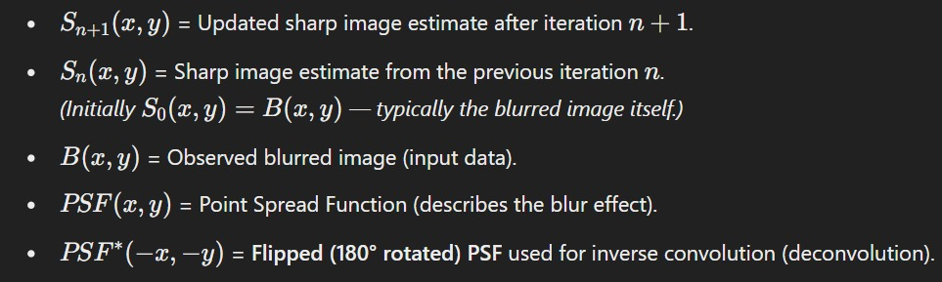
4: Update the Guess
We refine our current guess using the ratio R(x,y) and apply the PSF in reverse (deconvolution):
Sn+1(x,y)=S n(x,y)⋅(PSF ∗(−x,−y)∗R(x,y))
(*) PSF ∗ (−x,−y) Rotate the kernel around its center by 180 degrees.
(*) Multiplying by R(x,y) adjusts the sharpness based on the measured error.

Slide 9
Wiener filtering:
It is a mathematical techniques used for image deblurring and noise reduction. It Works on trying to reverse the blur while also reducing unwanted noise.
How Does Wiener Filtering Works?
When an image gets blurred, its pixels gets spread out based on certain blur pattern . Additionally, noise Can added due to factors like camera sensors, low light...etc.
Mathematically, A degraded image g(x,y) is modeled as:
g(x,y) = f(x,y)*h(x,y)+n(x,y)
f(x,y) = original image, h(x,y)= blur kernel ,n(x,y)=noise

Slide 10
spatial domain:
→ The image is represented as Pixel Values at (x,y) co-ordinates
→ It refers to an image as grid of pixels Where each pixel has as intensity or color value
Frequency domain:
→Fourier Transformer : converts an image from spatial domain to frequency domain
→ When we apply the Fourier Transformer the image is converted from spatial domain to the frequency domain
→ Instead of pixels, We now deal with sinusoidal frequency Components that describe Variations
in brightness.

Slide 11

Since Convolution in the spatial domain is difficult to solve directly , wiener filtering transforms the image into frequency domain using fourier transform.
G(u,v) = F(u,v)*H(u,v)+N(u,v)
Wiener filtering estimates the original image using the formula:
After apply the Winear filter in the frequency domain ,the result is transformed back into spatial domain using the Inverse fourier transform,giving us the restored image.

Slide 12
Each MATLAB method addresses specific limitations and artifacts associated with image blurring, setting up a refined input for the deep learning phase. This not only enhances the initial image quality but also allows the MPRNet to focus on extracting high-level features and performing finer detail restoration without being misled by residual blur or noise.

Slide 13
About MPRnet multi-stage progressive image restoration
MPRNet is trained using a lot of blurry and sharp images. 🔸 It compares the blurred image with the sharp image and learns the difference. 🔸 It keeps improving by fixing its mistakes using mathematical formulas. 🔸 After training, MPRNet can fix any blurry image it sees!
How MPRNet Uses Neural Networks
Feature Extraction:
MPRNet starts by breaking down the blurred image into features (details like edges, colors, shapes).
This is done using convolution operations. Mathematically, a convolution is just a way to filter an image and extract features.
Multi-Scale Processing:
MPRNet looks at the image at different scales (sizes). This is like zooming in and zooming out.
The network processes the image at fine details (small parts) and coarse details (larger parts) to capture all types of information.
This multi-scale approach helps it handle different kinds of blur (motion blur, defocus, etc.) effectively.

Slide 14
MPRnet in our project
1 Rough Fix (First Stage):
initial guess of the sharp image. Mathematically, it uses the convolution operation with learned filters (kernels) to remove the main blur, but there are still some small errors(to avoid these errors we first pass the image into the matlab for image deblurring using traditional concepts)
2 Refinement (Second Stage):
It applies more convolutions, adjusts the features, and tries to sharpen the image step by step.
3 Final Enhancement
MPRNet fine tunes the image to make it as sharp as possible. It adjusts the image using the same convolutional operations but focuses on the smallest errors
4 Backpropagation
This is a process where the model looks at the loss and adjusts the filters to improve the next prediction.It uses gradient descent

Slide 15
Loss Function
loss function tells the model how far the deblurred image is from the original sharp image
We are using MSE
MSE = (1/n) * Σ (Blurred Pixel - Restored Pixel)²
n is the total number of pixels in the image.
Blurred Pixel is the value of each pixel in the blurry image.
Restored Pixel is the value of each pixel in the deblurred image.

Slide 16
MPRNet Architecture and Training Outputs Explained
Encoder-Decoder Structure:
Encoder: Converts the input from a blurred image into a set of features by increasing the channel depth from 3 to 128. This helps in capturing essential details from the blurred images.
Decoder: Reconstructs the deblurred image from these features by gradually reducing the channel depth back to 3, aiming to match the sharpness of the original image.
Training Dynamics:
Loss Functions:
L1 Loss: Directly reduces the error in pixel brightness and color between the deblurred and the original sharp image.
Perceptual Loss: Ensures that the textures and structures in the deblurred image closely resemble those in the original image.
Metrics Used:
PSNR (Peak Signal-to-Noise Ratio): Measures the quality of the deblurred image compared to the original. Higher PSNR means better image quality.
SSIM (Structural Similarity Index Measure): Assesses the visual impact of three characteristics of an image: luminance, contrast, and structure.

Slide 17
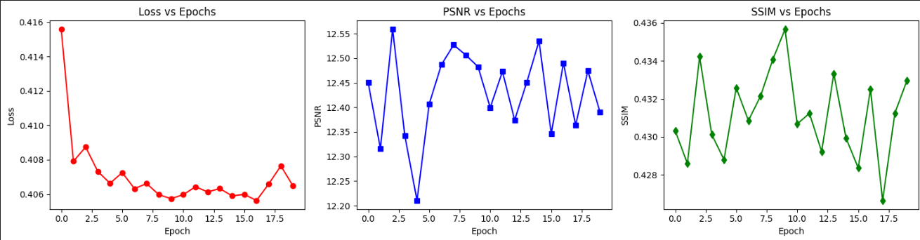
Initial Improvements: The loss decreases significantly in the early epochs, indicating that the model quickly learns to correct major blurring.
Fluctuations in Metrics: PSNR and SSIM values fluctuate as the model balances improving pixel accuracy and maintaining image quality, which is typical in complex tasks like image deblurring.

Slide 18
Training the Model
Phase 1 Training: Using CelebA dataset
Model Evaluation (Performance Metrics)
Loss vs Epochs → Measures training progress.
PSNR vs Epochs → Higher = better deblurred quality.
SSIM vs Epochs → Measures structural similarity.
Model Testing and Validation
Metrics Used:
Loss (How far predictions are from ground truth)
PSNR (Peak Signal-to-Noise Ratio)
SSIM (Structural Similarity Index Measure)
Model Saving & Deployment

Slide 19
Fix PSNR & SSIM Fluctuations
Increase epochs and fine-tune the learning rate scheduler.
Adjust loss function weights for better balance:
L1 Loss (50%)
Perceptual Loss (50%) (previously 40%).
Increase Training Stability
Cosine Annealing LR Scheduler: Smooth learning rate decay.
Better weight balancing for loss functions.
Improve Model Robustness
Increased perceptual loss contribution.
More augmentation techniques (random noise, blur variation).

Slide 20
Thank you Mam

